Slide 1
Hybrid Model for Diabetes Prediction

Slide 2
INTRODUCTION
Diabetes is a serious problem of the modern world in which blood sugar remains above a certain desired level on a sustained basis. Overtime it can lead to heart diseases, stroke, kidney diseases, nerve damage, foot problems, etc.
Thus a machine learning model that can efficiently learn from the historical data and use it predict whether a person will have diabetes or not will prove to be a boon to the world.

Slide 3
THE DATASET
The dataset used is originally contributed by the National Institute of Diabetes and Digestive and Kidney Diseases. It has 768 instances and 9 attributes. The goal is to predict whether a patient has diabetes based on diagnostic measurements.
All patients here are females at least 21 years old of Pima Indian heritage.
Se. No. | Attribute | Description | Datatype
1 | Pregnancies | Number of times pregnant | int64
2 | Glucose | Plasma glucose concentration | int64
3 | BloodPressure | Diastolic blood pressure (mm Hg) | int64
4 | SkinThickness | Triceps skin fold thickness (mm) | int64
5 | Insulin | 2-Hour serum insulin (mu U/ml) | int64
6 | BMI | Body mass index | float64
7 | DiabetesPedigreeFunction | Diabetes pedigree function | float64
8 | Age | Age of patient (in years) | int64
9 | Outcome | Class variable. 1 for diabetic and 0 for non-diabetic. | int64

Slide 4
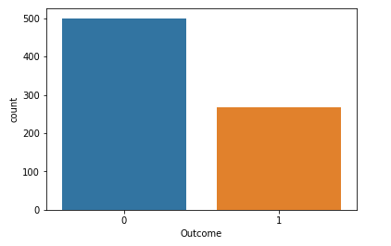
DISRIBUTION OF POSITIVE AND NEGATIVE OUTCOME

Slide 5
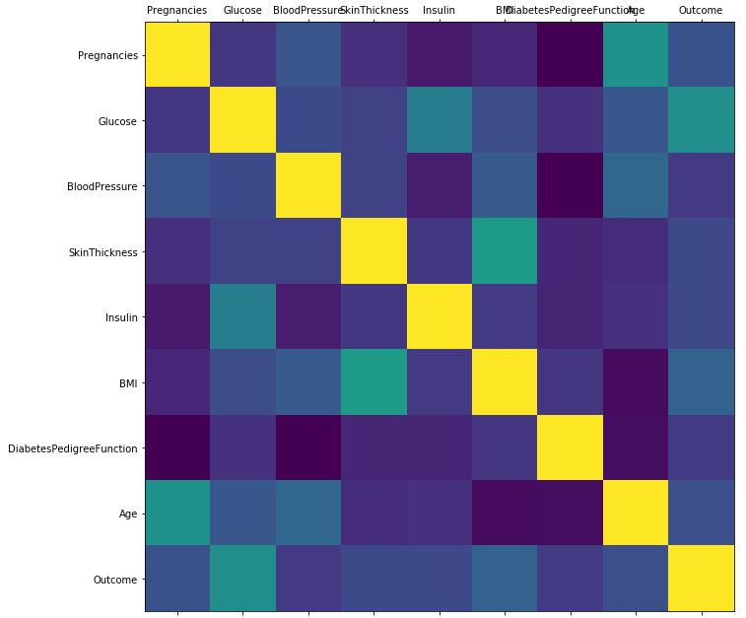
CORRELATION BETWEEN THE ATTRIBUTES

Slide 6
MODEL SELECTION
It is the phase where we select the model whose calibration and reliability estimate performs best for the data set at hand.
Classification Accuracy (Testing Accuracy) of a given set of classification models is calculated with their default parameters to predict which model can perform better with the diabetes data set.

Slide 7
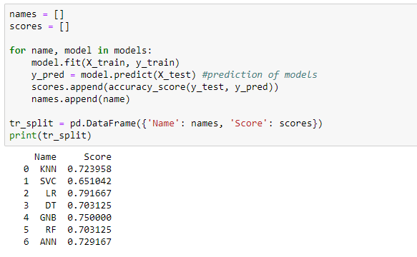

Slide 8
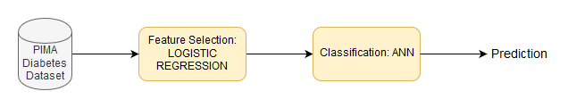
THE HYBRID MODEL
The project’s hybrid machine learning model is made up of two basic blocks.
Logistic Regression for feature selection using Recursive Feature Elimination (RFE) is used. RFE recursively removes attributes by comparing model accuracy with different combinations of attributes.
Classification – ANN

Slide 9
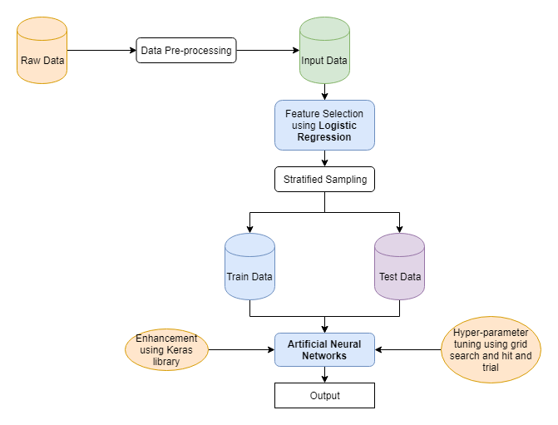

Slide 10
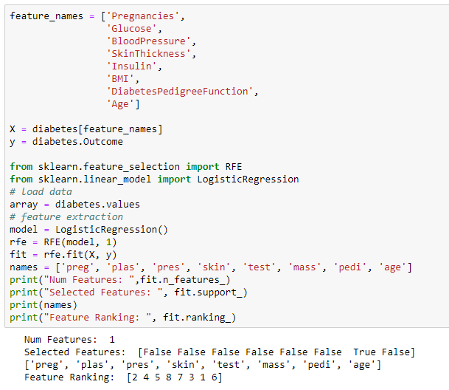
FEATURE SELECTION

Slide 11
FEATURE SELECTION
The RFE function ranks the attributes:
DiabetesPedigreeFunction> Pregnancies > BMI > Glucose >BloodPressure> Age > Insulin >SkinThickness
SkinThickness can be removed as it isn’t contributing much to the prediction of diabetes.

Slide 12
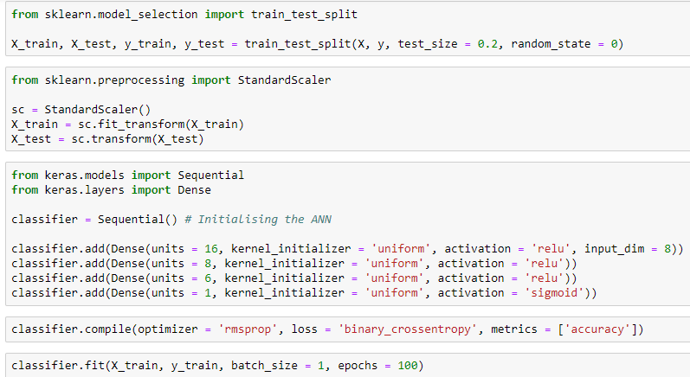
CLASSIFICATION

Slide 13
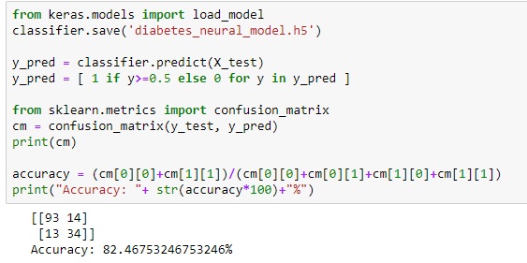

Slide 14
ANN HYPERPARAMETER TUNING- GRID SEARCH
Grid Search (or Parameter Sweep) is an exhaustive search. The space of the hyper-parameter is specified manually and the value of the hyper-parameter with the best accuracy rate is selected.
Hence, Grid Search gives an estimate of all the hyper-parameters and then, by some hit and trial, we get our set of hyper-parameters to plug in the model.

Slide 15
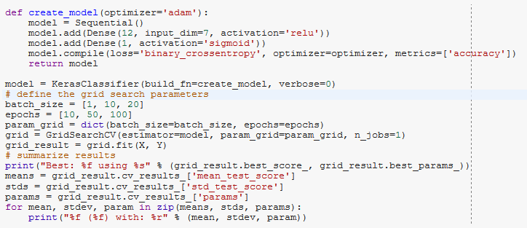
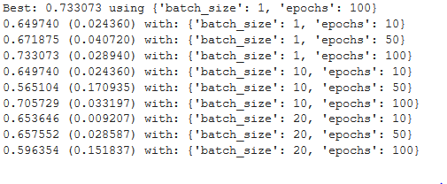

Slide 16
The hyper-parameters used in the model:
Batch: 1
Epoch: 100
Optimizer: ‘rmsprop’
Loss: 'binary_crossentropy'
Activation function: ‘relu’, ‘sigmoid’
Kernel initialize: ‘uniform’
Number of layers: 4
Units in each layer: 16, 8, 6, 1

Slide 17
THE ENSEMBLE MODEL
In ensemble model, various base classifiers are combined into one model. The concepts of bagging and boosting are applied.
Based on the accuracy the best classifier out of the ensemble is selected.
In this project, an ensemble model of LR and neural networks is created using the VotingClassifier function available in the sklearn library of python.

Slide 18
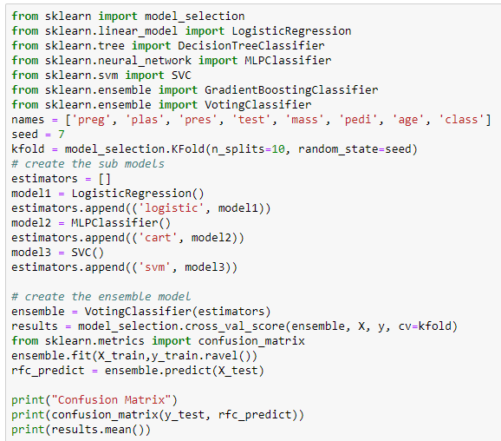


Slide 19
RESULTS TABLE
Model | Accuracy | Specificity | Sensitivity | F1-Score
Logistic Regression | 0.7789 | 0.8645 | 0.5921 | 0.6809
ANN(without hyper-parameter tuning) | 0.7857 | 0.8691 | 0.5957 | 0.6291
ANN(with hyper-parameter tuning) | 0.8052 | 0.7944 | 0.8298 | 0.7222
Ensemble | 0.7512 | 0.9120 | 0.4179 | 0.5283
Hybrid | 0.8377 | 0.8785 | 0.7447 | 0.7369

Slide 20
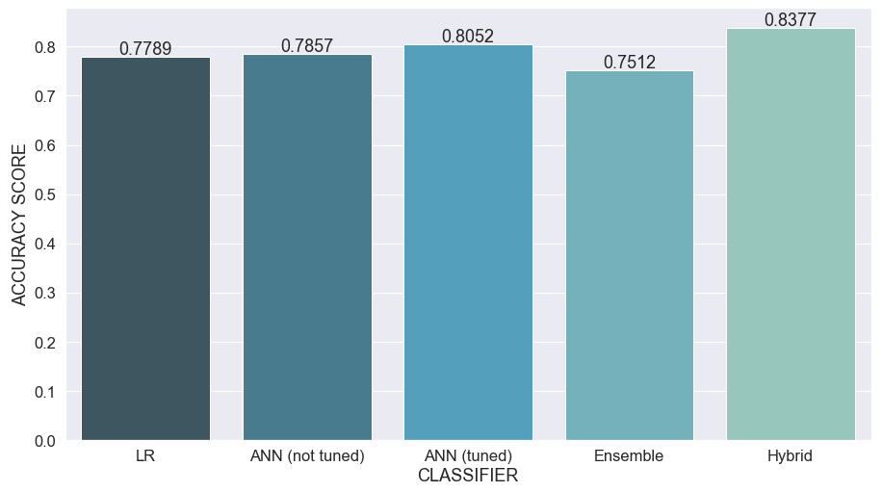
Accuracy vs Model

Slide 21
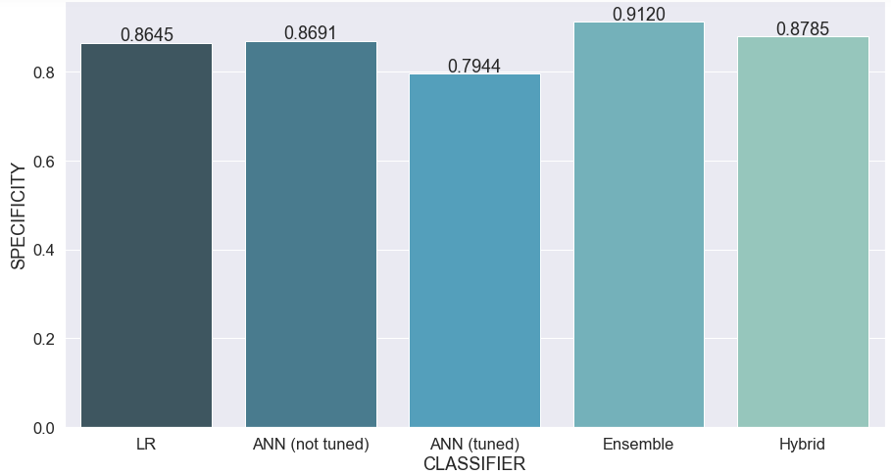
Specificity vs Model

Slide 22
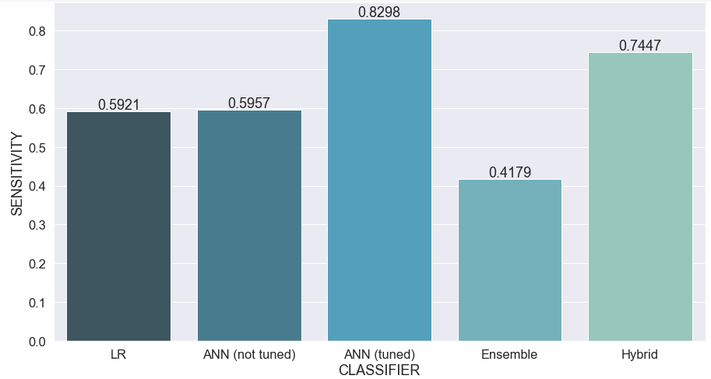
Sensitivity vs Model

Slide 23
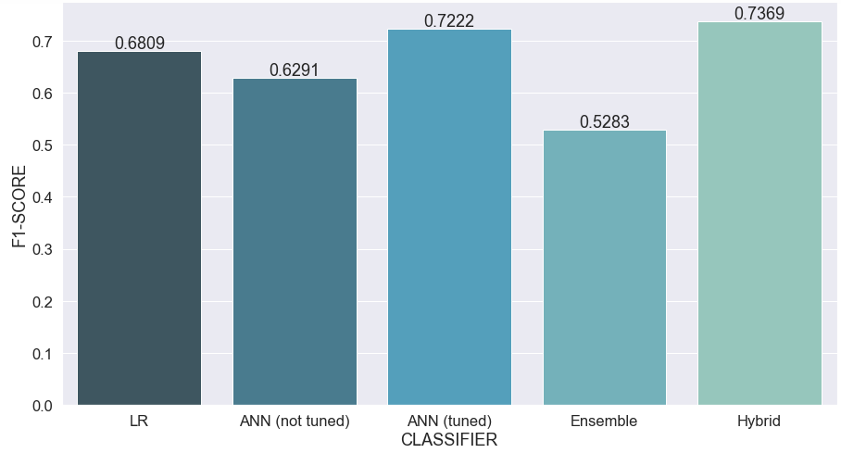
F1 Score vs Model

Slide 24
Discussion
Hybrid model gives the best accuracy for the diabetes dataset whereas the Ensemble model gives the least. Ensemble models do not guarantee higher accuracies as they basically average the results of classifiers. Thus, if a good model is averaged with a bad model, it produces a fairly bad model. In ensemble model, sampling is done. Some samples receive the good attributes while some samples receive the bad ones. Thus, some models give better accuracy while others don’t.
Hybrid models perform the best because they can be modified according to the need of classification. Feature selection is performed and the attributes with the least importance are dropped. Also, the ANN classifier is enhanced and hyper-tuned. This improves the accuracy of the model.

Slide 25
THANK YOU!

